Slide 1
Donor Mapping for GBV Activities in the DRC

Slide 2
Plan
Context: Magnitude of GBV in DRC in 2020
Context: Severity of GBV in DRC 2021
Methodology used to collect data on donor mapping
Key results
Leveraging findings for advocacy
Notes:
Ampleur de

Slide 3
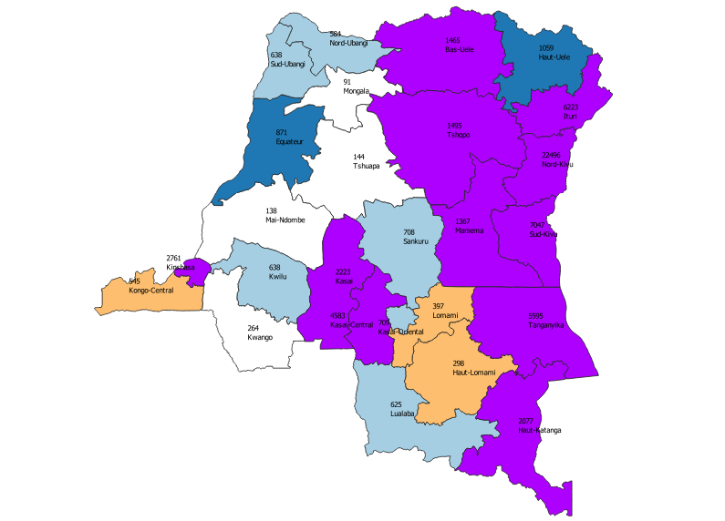
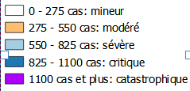
1. Magnitude of GBV in 2020 in the DRC
Context
Magnitude of VBG
Armed conflicts in Ituri, North Kivu, South Kivu
Inter-community conflicts in Tanganyika, South Kivu and Maniema, Ituri
Cyclical movement of populations: displaced & return
Land and customary related conflicts in the Kasai region
Urban insecurity and COVID-19 impacts

Slide 4
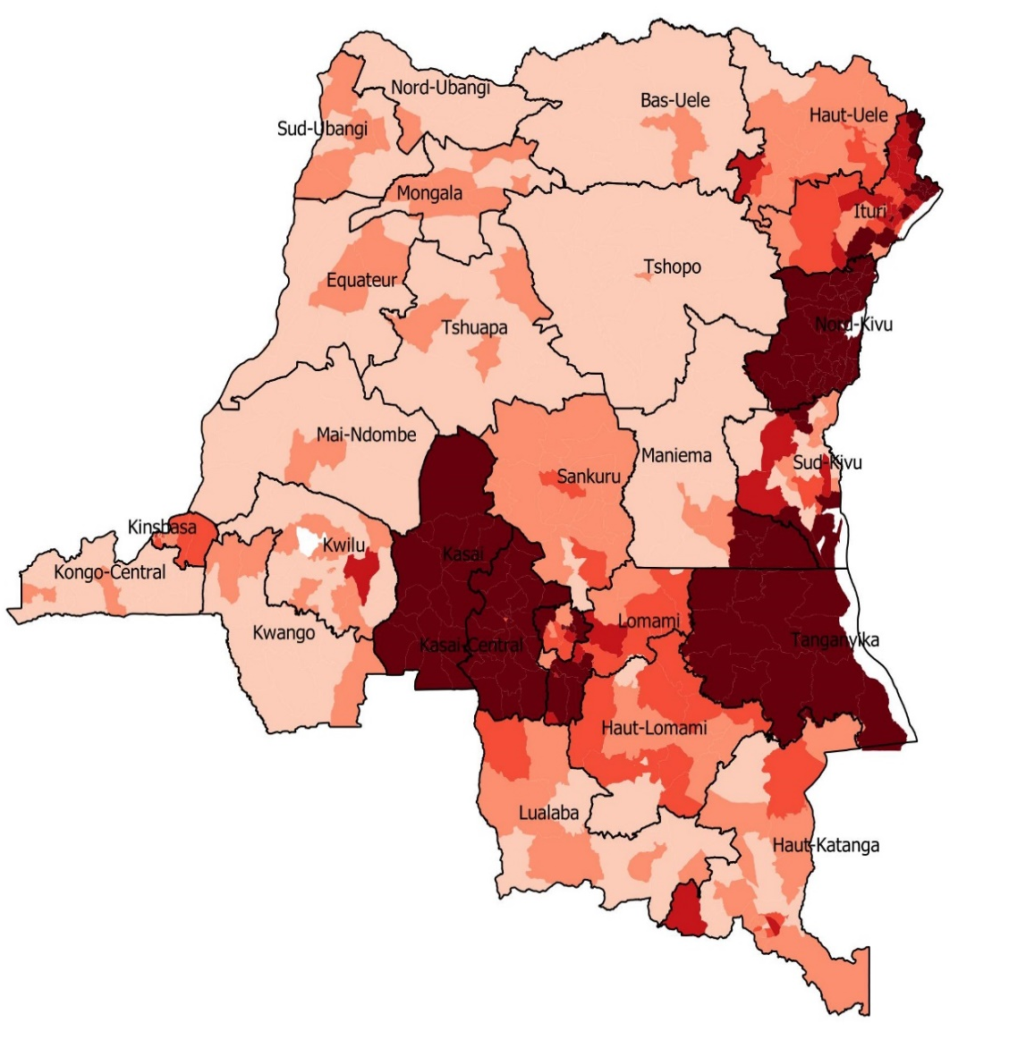
2. Mapping of severity of GBV in DRC
7 provinces have a catastrophic severity level
13 out of 26 provinces have a critical severity score
6 provinces have a severe level
The severity score is obtained by combining population movement and food insecurity

Slide 5
3. Objectives of the mapping
Identify humanitarian hubs where GBV prevention and response projects are funded
Identify donors who fund GBV prevention and response activities
Identify funding gaps based on the duration of current funding
Understand the nature of donors and the responses funded (humanitarian versus development)
Advocate with the donor community in the DRC on the funding gaps for GBV interventions

Slide 6
4. Data collection methodology (i)
Development of information needs by the Coordination after consultation with the GBV Sub-Cluster
Development and validation of indicators depending on the information need
Development of an excel data collection matrix by the GBV Sub-Cluster IM Team
Data collection for 10 days with members of the Sub-Cluster

Slide 7
4. Data collection methodology (ii)
Information processing by the IM team in collaboration with regional GBV SC coordinators
Review and validation of data by the IM team
Production of a mapping by the IM team
Data analysis and development of a narrative by the coordination.

Slide 8
5. List of indicators
Indicators | Contents | Explanation
Geographic Coverage | Number of humanitarian hubs funded by a project | It indicates the humanitarian hubs with funding on the 4 regional humanitarian hubs in the DRC
Funding type | Number of projects disaggregated by type: humanitarian and development | It indicates the funding dedicated for the response to GBV in humanitarian emergencies versus the response to GBV in development situations.

Slide 9
5. List of indicators (ii)
Indicators | Contents | Explanation
Type of organization receiving funds | Number of funded partners disaggregated by type: UN, international NGO, national NGO, Women's organizations | It indicates the number of projects by type of recipient. It makes it possible to analyse whether location issues are taken into account when granting funds to members of the Sub-Cluster
Project duration | Number of projects disaggregated by duration: less than 6 months, 12 months, 3 to 5 years | It indicates the duration of projects and makes it possible to identify the gaps in terms of project duration by humanitarian hubs

Slide 10
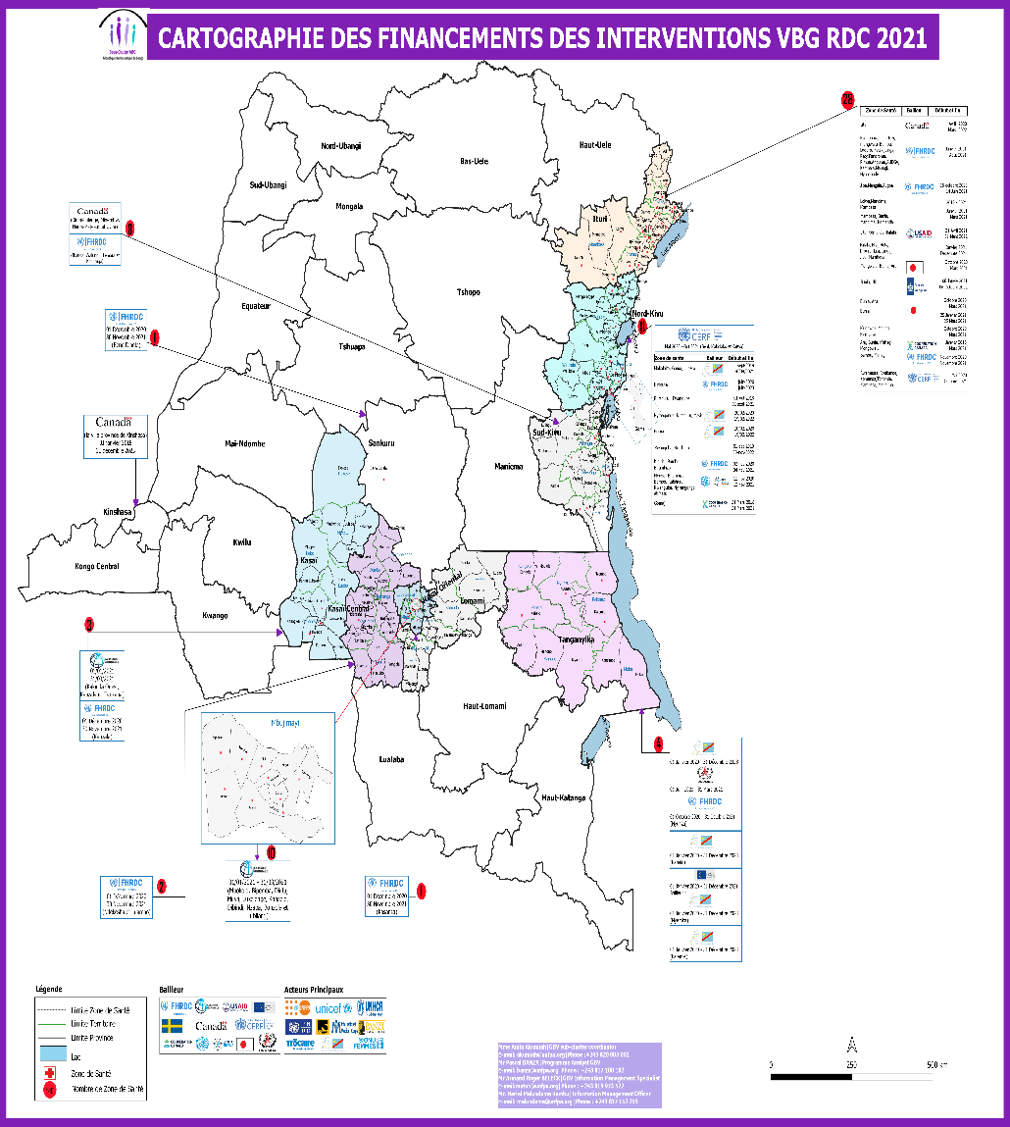
6. Funding mapping
60% of funding is concentrated in the eastern provinces where there is a high severity of GBV
71.8% of projects are devoted to responding to humanitarian crises
80% of projects have a duration of 12 months the rest 20% vary between 3 to 5 years

Slide 11

7. Funding mapping versus severity mapping

Slide 12
8. Main Results: Geographic Coverage
53% of funding is concentrated in the humanitarian hub of North East (Province of North Kivu and Ituri)
The Central East (South Kivu & Maniema), South East (Tanganyika & Haut Katanga) and Kasai hubs benefit from small funding despite the severity of GBV

Slide 13
8. Main Results: Funding by Donor
40.6% of funding comes from the DRC Humanitarian Fund.
The funding of the WB either directly or via the Social Fund of the Republic is 21.8%
Canada's funding for both humanitarian response and development response is 15.6%

Slide 14
8. Main Results: Funding Recipients
46% of funding has been granted to International Organizations
20% of funding has been granted to NGOs.
Funding for women lead organizations represents only 1%
UN Agencies received 33% of funding but this funds NGOs including local organizations

Slide 15
8. Main Results: Duration of projects
60% of funding covers a period of 6 to 18 months
30% go beyond 18 months
10% of funding covers a period of 1 to 6 months

Slide 16
9. Activities Funded
Funding for Response Activities - 80%
Medical – 43%
Psychosocial - 47%
Legal – 3%
Socio Economic Reintegration – 7%
Funding for Prevention Activities – 10%

Slide 17
10. Use of the results of the funding mapping by the GBV SC
Advocacy with the donor community in the DRC for the financing of underfunded crises in Tanganyika, Maniema Kasaï Central & Kasaï
Advocacy with the Inter Cluster in the DRC for capacity building of NGOs and in particular women's associations to enable them to access funding

Slide 18
10. Use of the results of the funding mapping by the GBV SC
Advocacy with the donor community in the DRC for granting more funds to NGOs and women's associations
Round table with donors of the DRC to advocate for funding of resilience projects: empowerment of women, coordination strengthening, Humanitarian-Development Continuum

Slide 19
11.Lessons Learned
The need to engage donors directly to have information on funds given to partners owing to the sensitivity of divulging financial matters
Relationship between the donor community, the GBV sub-cluster and GBV actors. The need for accountability

