Slide 1
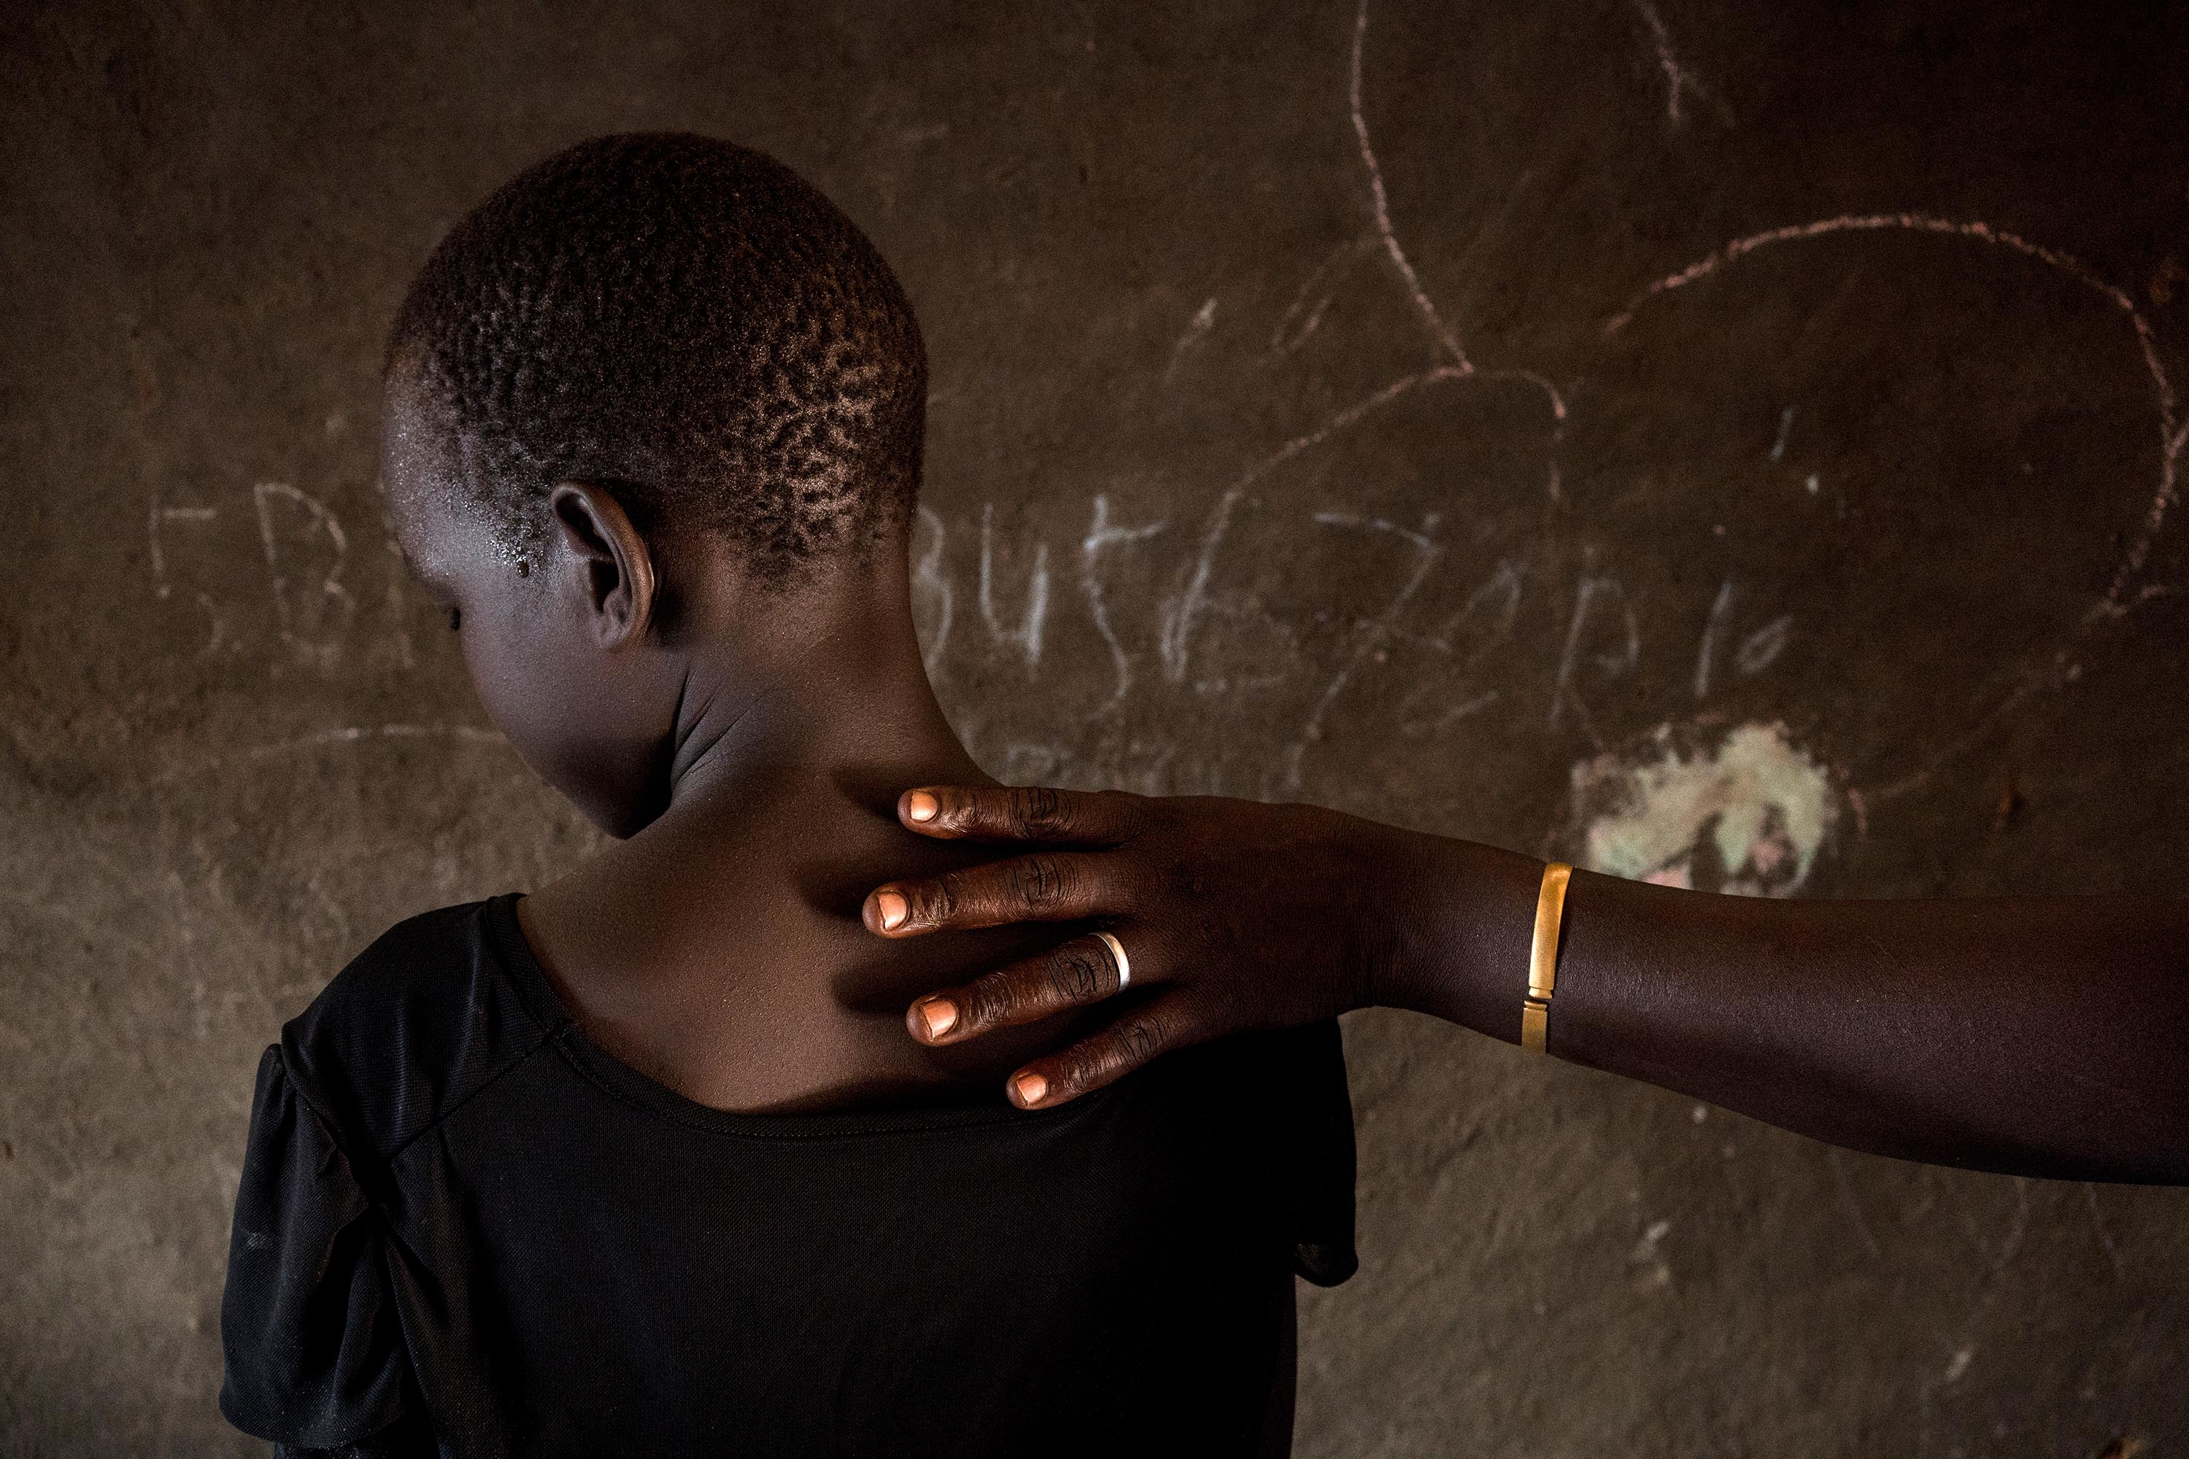

Gender sensitive Reporting

Slide 2
What will we cover today
What is gender? What is gender equality? Why does it matter?
Understanding stereotypes and the role of media
5 Ws of Gender sensitive Journalism
Practical tips

Slide 3
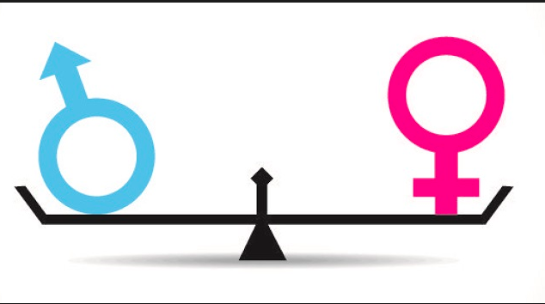
Gender equality is …
equality between men and women…does not mean that women and men have to become the same, but that their rights, responsibilities and opportunities will not depend on whether they were born male or female.
Gender equity
means fairness of treatment for men and women according to their respective needs.
(UNESCO)

Slide 4

EQUALITY = the end goal
EQUITY = the means to get there

Slide 5

Wear the gender lens
It is the capacity to see in any phenomenon, project, programme or event differences between the situation for women and men, and determine whether or not these differences result in inequality

Slide 6
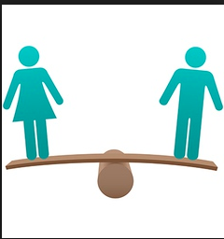
Why?
Out of 1,000 people, 504 are men and 496 are women (for every 100 girls, 107 boys are born, but males have a higher risk of dying than females)
Women are less likely than men to join the labor force and to work for pay
They are more likely to work part-time, in the informal sector, or in occupations that have lower pay
Gender inequality disempowers women and girls in ways that deprive them of their basic human rights

Slide 7
Why?
This lack of opportunities for girls/women entails large economic costs for them, their households and their countries.
On a per capita basis, gender inequality in earnings could lead to losses in wealth of $23,620 per person globally.
The loss in human capital wealth due to gender inequality is estimated at $160.2 trillion if we simply assume that women would earn as much as men. This is about twice the value of GDP globally. Human capital wealth could increase by 21.7% globally, and total wealth by 14% with gender equality in earnings.

Slide 8
Gender inequality in South Sudan
Even during ‘peace time’, approximately 60% women report having experienced GBV; 53% perpetrated by intimate partner (GBVIMS, 2019)
Women of childbearing age (15-49 years old) constitute about 24 per cent of the total population
4 out 10 girls married of before the age of 18; the risk of child marriage will increase as the economic hardships unfold in the aftermath of COVID-19
Women survivors of physical or sexual abuse are twice as likely to have an abortion; nearly doubles their likelihood of falling into depression – with 60% women in SS facing this risk, approx. 3 million women at risk

Slide 9

Sex Vs Gender
Sex refers to biological, physical and physiological characteristics that distinguish men and women.
Gender refers to:
The social construction of masculinity and femininity;
Includes an analysis of norms, roles and relationships of and between groups;
Changes over time, and varies between societies;
Reflects a system of power relations and dynamics, and influences access to resources, power, privileges and status
Gender interacts with other characteristics such as age, class, race, ethnicity etc.

Slide 10
Who Is What?
 | WOMEN |  | MEN
REPRODUCTIVE ROLE | Gives birth to and breastfeeds children. | Biologically determined. | Fathers children. |  | Biologically determined.
EXAMPLES OF SOCIALLY CONSTRUCTED ROLES
IN THE HOME | Care, nurture children | Socially determined-limits women’s role to the home; unremunerated. |  | Protect, provide. | Socially determined; limits men’s caring and nurturing role.
IN THE WORK PLACE | Care work-domestic workers, secretaries, nurses, primary school teachers. | Extension of role in the home; limits women’s management and leadership roles; more poorly paid jobs |  | Leadership and management roles-in politics, business; security (police, defence, foreign affairs) | Extension of social construction; exacerbates gender imbalance in power, economic clout
IN THE PERSONAL SPACE | Humble, submissive, listening, emotional, caring. | Limits ability to be assertive, break into new roles |  | Talkative, decision-making, ambitious, aggressive | Limits ability to be humane and caring; to express emotion

Slide 11
Media and Society
1. In what ways does the media reflect reality?
2. In what ways does the media shape reality?
The media report on what happens
The information that journalists provide shapes how people perceive things
People’s perceptions inform their choices and actions
People’s actions inform what happens

Slide 12
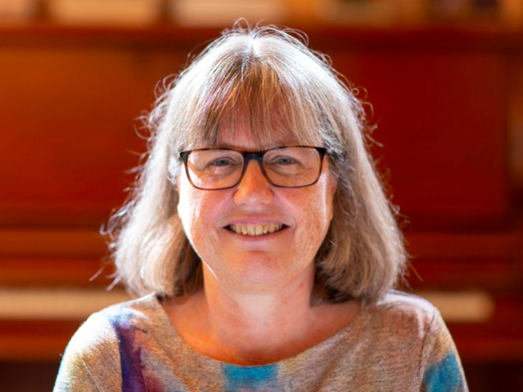
Donna Strickland
Nobel Prize for Physics 2018

Slide 13
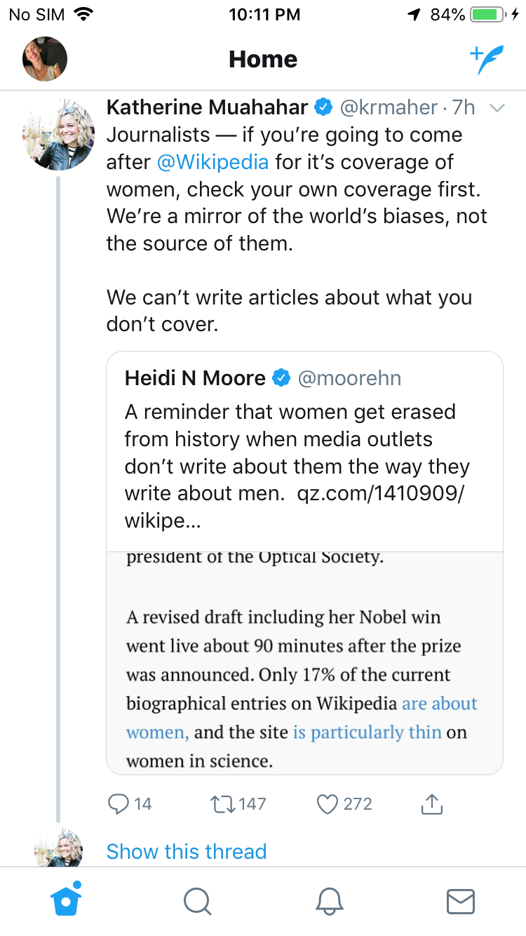

Slide 14
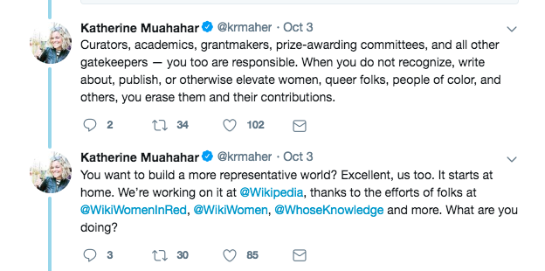

Slide 15
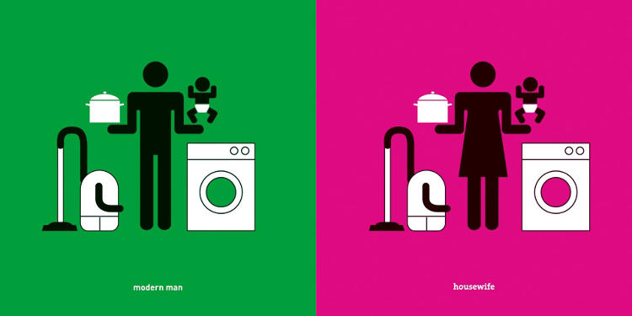
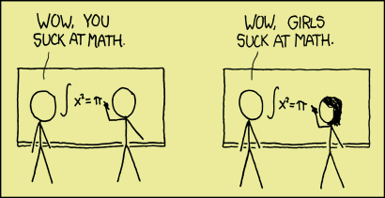

Slide 16
Stereotypes
A generalised view or preconception about attributes or characteristics that are or ought to be possessed by men and women.
Often widely held, and denote what community members think should be the roles for women and men.
Mostly inaccurate, socially constructed beliefs
Mostly transmitted through society’s institutions, including religion, educational institutions, political institutions and the media

Slide 17
Stereotypes
Examples of stereotypes about women | Examples of stereotypes about men
A good woman should be quiet and should not speak out | A good man should speak out and be heard
Women are emotional beings who cry | Men are not emotional, and they cannot cry
Women are weak | Men are strong
Women are peaceful and non-violent | Men are aggressive and violent

Slide 18
Reporting on Gender
Should the media
reflect gender roles as they currently stand?
OR
challenge those roles?

Slide 19
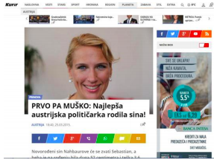
Stereotypes in News
It was published as a headline in the online issue of newspaper Kurir. The story was about the private life of a woman politician (her motherhood) which is completely irrelevant to her public office, with a close-up photograph of her smiling and focusing on her good looks.
First – boy: the most beautiful Austrian politician gave birth to a baby boy!

Slide 20
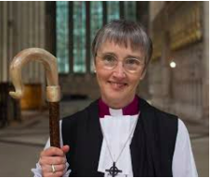
And challenging them
Alison White was the second bishop appointed in the UK in 2015. The institution of religion is very conservative in Belarus. For a long time, taking up a religious office was forbidden for women. It is relevant because both the institution and the people largely ignore women’s participation, an attitude based on the idea that a woman cannot be a ‘spiritual leader.

Slide 21
The 5Ws of Gender-Sensitive Journalism
WHO | Traditional outlets – newspapers, radio, TV – and new media alike. Bloggers, reporters, editors, editors-in-chief, photographers, managers, editorial board
WHAT | To portray and treat women fairly in news reports, with an attentive approach to avoid inequalities, stereotypes, and discrimination as well as in their multi-faceted roles
WHY | Fair gender portrayal is a professional and ethical aspiration, similar to respect for accuracy, fairness and honesty. It can importantly contribute and co-create more gender balanced and inclusive societies. Because a man’s world does not reflect the actual composition of society, it fails to show the variety of human experiences, making the female part of our societies relatively invisible.
WHERE | Across media outlets as a whole – from the managerial department setting the editorial line to the field where information is gathered, to the newsroom where the story is packaged
WHEN | At every stage of the news gathering process
HOW | Gender-sensitive selection of topics and sources and stories, use of gender-fair language, and promoting gender equality within media outlets

Slide 22
The 5 principles of gender-sensitive reporting
Balance the presence of women and men in media coverage to mirror the society, human experiences, actions, views and concerns.
Avoid gender stereotypes that do not mirror the world and its possibilities and perpetuate a bi-dimensional portray of the society
Weigh the representation of women and men, making sure to give equal voice to women, including as experts, in often male-dominated areas – such as politics and government, economic and business, war and conflicts, science and technology, sports
Use gender-sensitive language
Cover gender equality issues and discussions as an important and integral part of the media’s role as a watchdog of society

Slide 23
Some tips
Ensure an equal range of speakers:
Seek women’s and men’s voice equally. Treat them equally as well.
Consult a variety of sources, representing a broad spectrum of views
Include women as experts, also in often male-dominated areas – such as politics, economic and business, peace process, science and technology, sports.
If you cannot find female experts, ask yourself why
Solicit the views of gender-focused organisations and agencies
Tell the story in a gender-sensitive way
Ensure that the coverage reflects a holistic and realistic view of women
Avoid reinforcing stereotypes, whether blatant or subtle. Challenge stereotypes instead.
Treat all subjects with dignity. Avoid belittling women’s experiences and concerns.
Provide adequate context and balance and analysis, which includes going beyond the event to raise the underlying issues.
e aware of and make reference to the legal and policy frameworks that govern gender issues in South Sudan, and the status of their implementation

Slide 24
Some tips
Language:
Use language that is inclusive of men and women, (e.g. gender-neutral terms used instead of gender-biased terms)
Use adjectives that are objective and relevant, instead of ones that convey biases or stereotypes
Provide relevant gender disaggregated data
Visual representation of women in the media
Represent women and men equally
Use a range of images that portrays women and men in all their diversity
Avoid using images that emphasize/ exaggerate physical or sexual aspects
Avoid images that degrade the dignity of women
Who tells the story?
Ensure that both women and men report on gender and women’s issues, not only women
Recognise gender as an important factor, and ensure that it includes both women’s and men’s concerns
Ensure that sub-editors are sensitised to gender as regards editorial issues.

Slide 25
Thank you!

