Slide 1
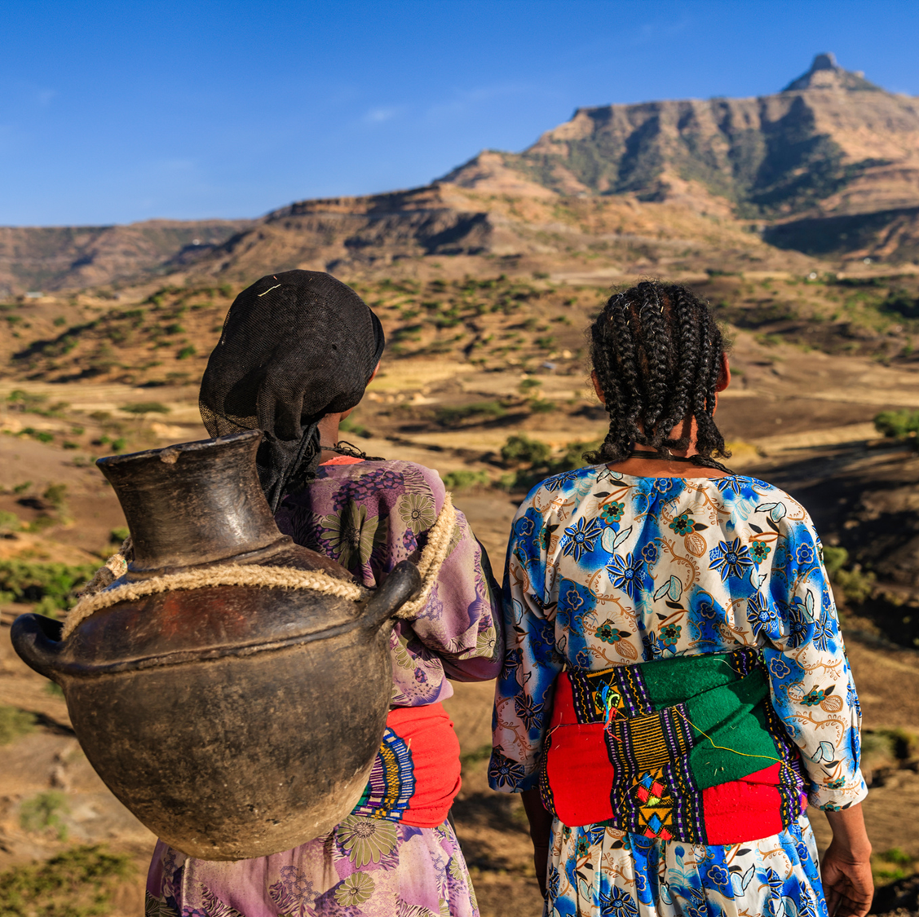

Humanitarian Briefing:
COORDINATION OF
GENDER-BASED VIOLENCE
SERVICES IN CONLFICT and DROUGHT AFFECTED COMMUNITIES IN ETHIOPIA

Slide 2
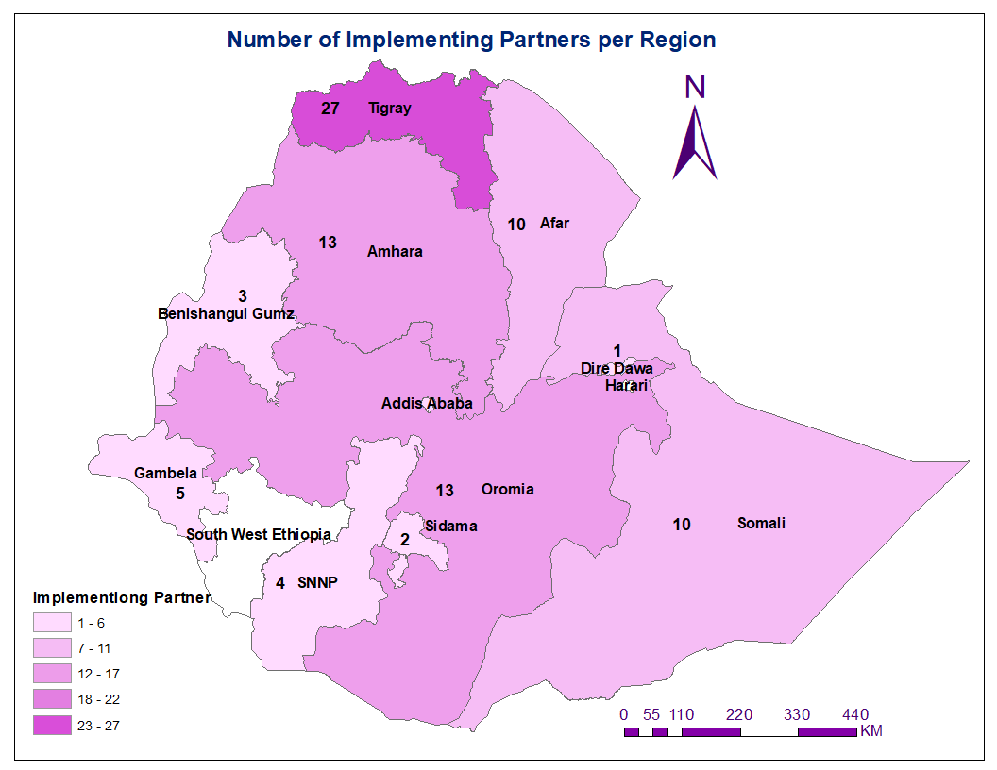





2021 GBV AoR Snapshot
PiN People Targeted Beneficiary Reached
3.5M 1.1 M 761 K
Regions Zones Woredas
11 79 20% of Target
Implementing Partners
56
INGO (63%), LNGOs (34%), Gov’t (3%)

Slide 3

GBV overview 2022
People in need (PiN) for GBV as per 2022 draft HNO is 5.8 M an increase from 3.5M in 2021
In 2022, the target is 2.2 M people to be reached with GBV interventions, an increase from 1.1 M in 2021 – (100% increase)
The escalation of conflict in Northern Ethiopia led to a substantial increase of GBV, especially sexual violence across Tigray, Amhara and Afar regions. Response still needs to be strengthened.
In Northern Ethiopia high numbers of sexual violence cases were reported in Tigray, Amhara, and Afar during the conflict period (Reports from the regional bureaus)
GBV response needs are also high in Benishangul Gumuz, Somali, Oromia and SNNP regions as a result of conflict and drought.
Ethiopia currently has 45* one stop centres in the different regions which are core in the GBV response
Ease of access to Tigray for supplies (including dignity kits and RH kits), increase in cash allowance & movement of staff is a positive step for much needed GBV response .
124 Woredas in Somali , Oromia, SNNP and South West regions are affected by the drought.

Slide 4
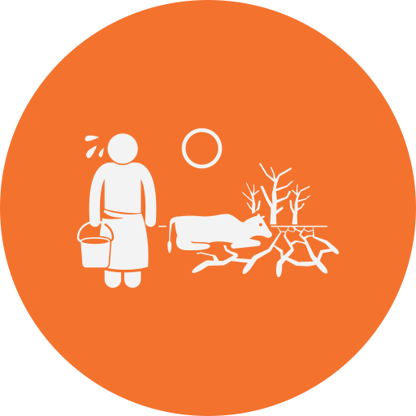
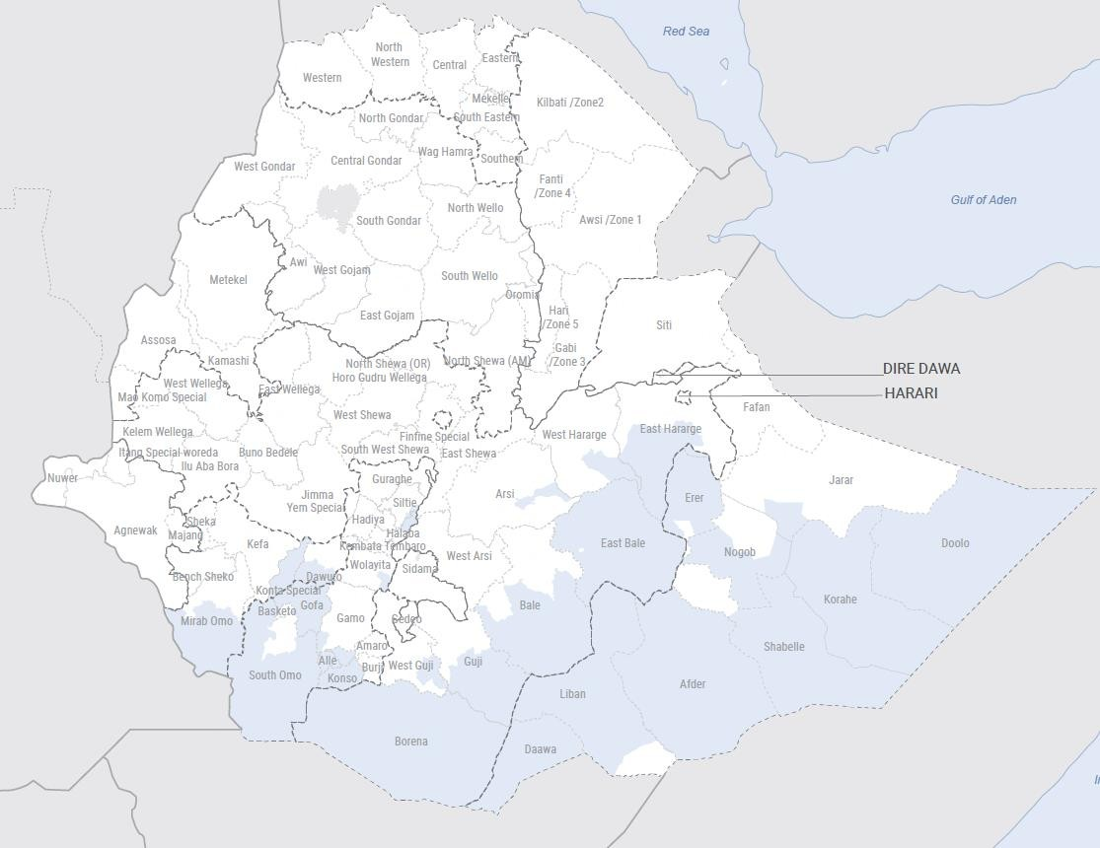
Drought affected Areas in Ethiopia
Region/zone | # drought affected woredas
Oromia | 36
Arsi | 1
Bale | 3
Borena | 14
East Bale | 7
East Hararge | 4
Guji | 5
West Guji | 1
West Hararge | 1
SNNP | 24
Alle | 1
Derashe | 1
Gamo | 1
Gofa | 9
Halaba | 1
Konso | 3
Siltie | 1
South Omo | 6
Wolayita | 1
Somali | 59
Afder | 9
Daawa | 4
Doolo | 7
Erer | 6
Fafan | 1
Jarar | 1
Korahe | 11
Liban | 6
Nogob | 5
Shabelle | 9
South West | 5
Dawuro | 2
Konta Special | 1
Mirab Omo | 2
Grand Total | 124

Slide 5


C
DRIVERS OF GBV IN ETHIOPIA
High risks especially sexual violence affecting women and girls
Disruption of core GBV services, weak referrals, lack of hotlines
Inaccessibility to available services for affected populations
Inaccessibility by aid workers due to presence of armed groups or ongoing conflict
CONFLICT
Women and girls are exposed to survival sex and SEA risks due to lack of access to aid and resources
Overcrowding in common shelters, lack of segregated WaSH facilities exposing women and girls to sexual violence and sexual harassment.
Lack of response services and basic commodities e.g. dignity kits, safe shelter, NFIs etc exacerbate risks and effects of GBV
DISPLACEMENT
Women and girls are exposed to survival sex and SEA risks due to lack of access to resources
Women & girls exposed to sexual violence as they travel further from the community for livelihood activities - water, firewood etc
Risks of early marriage for girls
Possible rise in domestic violence due to diminishing household resources and income
DROUGHT

Slide 6
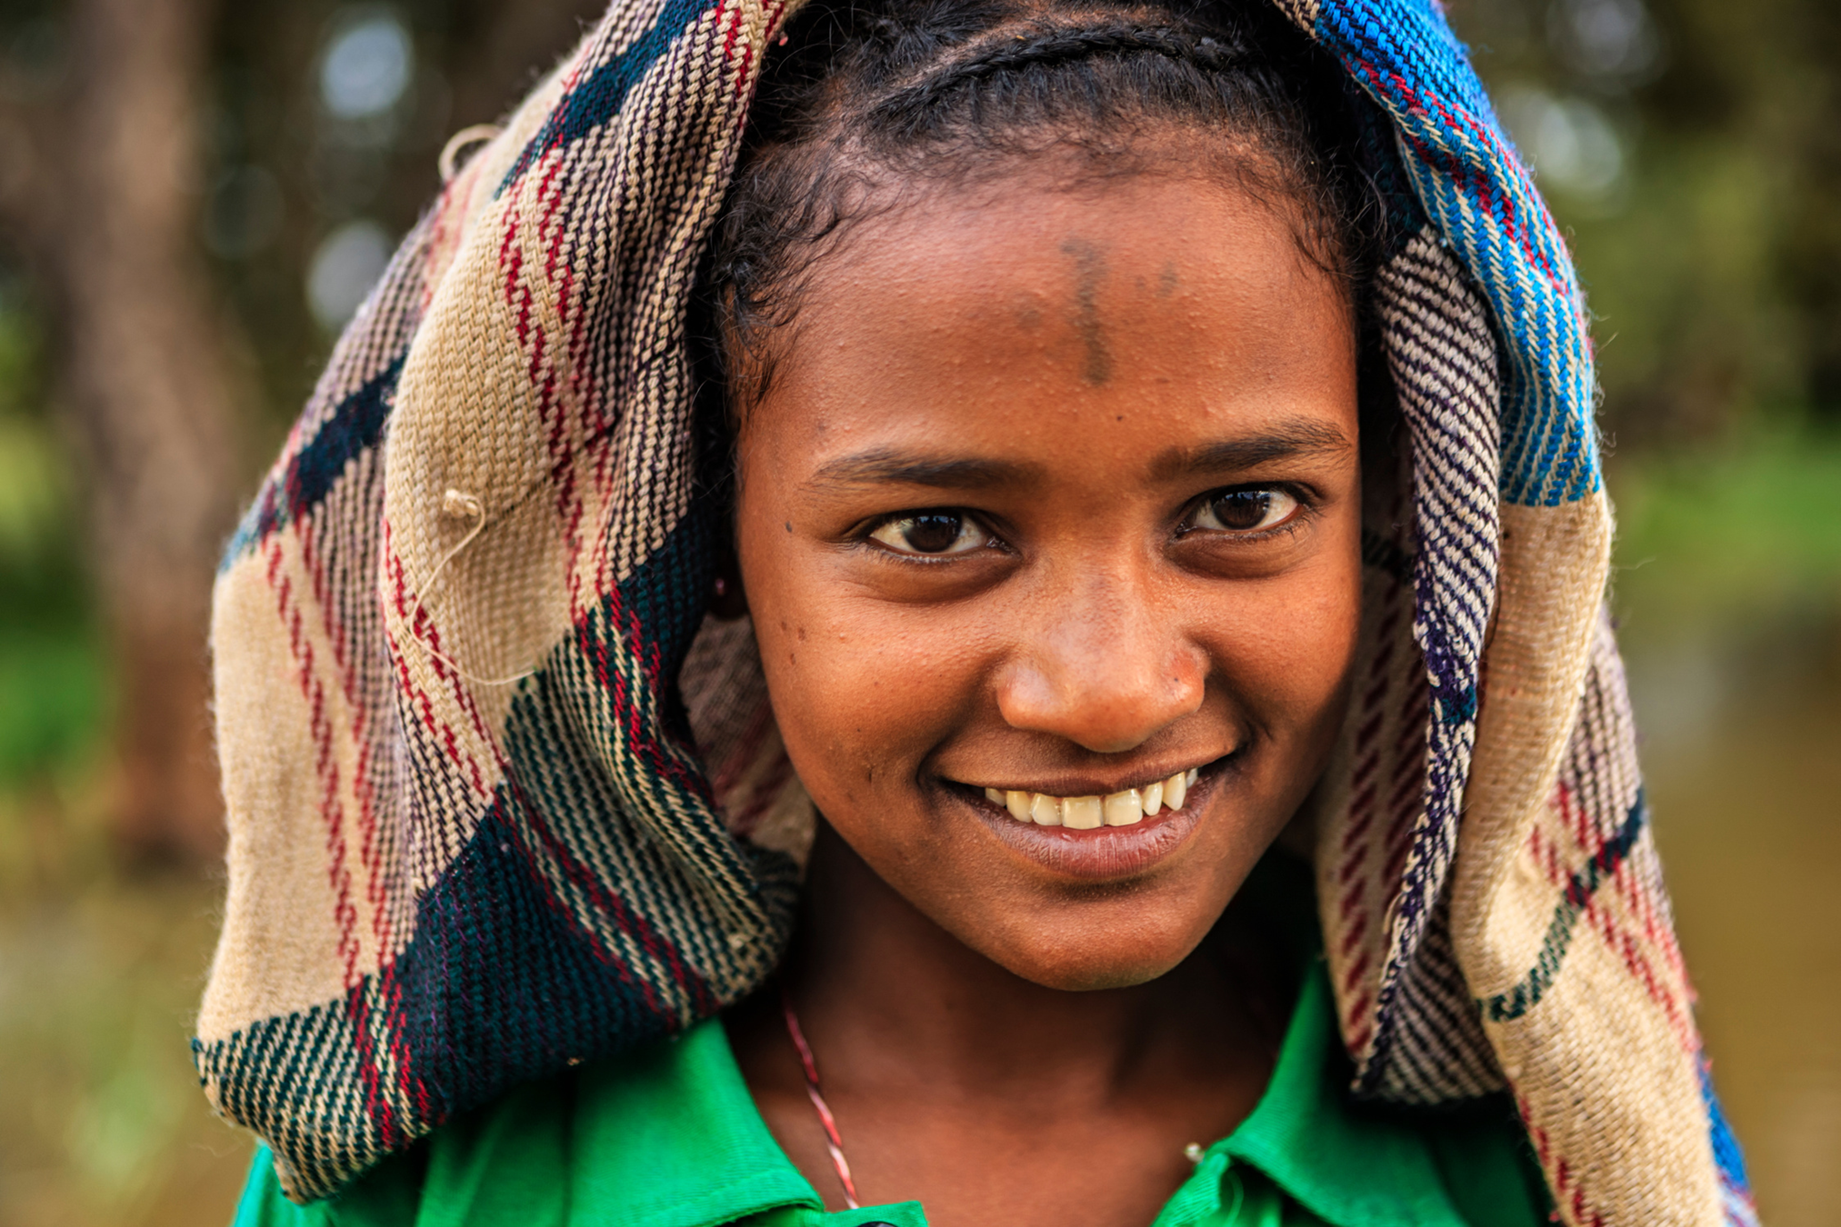
Funding needs & Response Priorities for 2022
The GBV AoR funding needs for 2022 as per the draft HRP is US$ 89M to address the following priority interventions:-
  Scale up GBV response through One Stop Centers (OSCs) and Women and Girls’ Friendly Spaces (WGFS)
  Strengthening GBV referral pathways via comprehensive GBV services and partner mapping.
  Community GBV awareness
  Distribution of dignity kits
  Strengthening GBV coordination mechanisms.
  Capacity building of frontline service providers
  Livelihood programming for vulnerable women & girls.
  GBV mainstreaming across the humanitarian response.
  Establishing GBV standard operating procedures (SOPs), GBVIMS+
  GBV assessments to inform programming and trends.

Slide 7
Ongoing GBV Response as of Feb’ 2022

Slide 8

# of Implementing Partners by GBV Activity
20
GBV
Awareness
Raising
17
PSS
15
Dignity
Kits
13
Capacity
Building
4
Case Management

Slide 9

GBV Donors and Partners as of Feb’ 2022
C
17
27
CERF
CIDA
ECHO
FCDO
GAC
IRC/RRM
Julia Tuft Fund
SIDA
SWAN
UNFPA
UNHCR
UNICEF
UNOCHA
USAID/BHA
WfW I
World Bank
Action Against Hunger
Alight
ANE
ASDEPO
AWA
BoWYCA
DRC
EDA
EDUKANS Foundation
EECMY DASSC
ELIDA
EMwA
EPA
FHI360
FIDO
GOAL ET
HI
IMAGINE 1 DAY
IMC
IRC
Mum for Mums
OXFAM
PLAN INT
SAVE THE CHILDREN
SYHLA
TdH NL
World Visions

Slide 10
GBV One Stop Centers

Slide 11

GBV Response Gaps, Constraints and Challenges
Insufficient funding compared to the needs with some areas extremely underfunded – e.g. Benishangul-Gumuz, SNNPR, Oromia and Somali
Insufficient presence of GBV partners to offer core GBV response services especially in hard to reach areas – parts of Benishangul-Gumuz, Oromia, Tigray, Afar
Disruption of GBV response infrastructure, institutional structures and support mechanisms.
Presence of armed groups across conflict-affected regions continues to hamper access for both affected population, and humanitarians
Desperate living conditions in displacement areas exposing women and girls to survival sex
Low number of partners providing comprehensive range of GBV response services
Gaps in coordination in some regions and weak mapping of services thus lack of localized referral pathways
Challenges in GBV data/ information management - Lack of data collection systems including GBVIMS thus challenges in informing trends

Slide 12

Key Asks
Prioritize GBV in the humanitarian response with a focus on the core GBV services (Health, case management, psychosocial support, Legal Aid, Safety and Security).
Ensure integration and mainstreaming within other sectoral interventions informed by robust sectoral GBV and Gender analysis.
Ensure adequate funding for GBV in the HRP as well as longer-term funding for sustainability linked to Humanitarian Development & Peace Nexus
Investment in livelihood interventions for Women and girls to address negative coping mechanisms such as survival sex, child marriages and to ease re-integration of GBV survivors.
Investment in capacity building of frontline service providers
More support for GBV AoR coordination and strengthening of GBV information management including GBVIMS+ and GBV stand-alone assessments
More advocacy on GBV issues at the regional and global levels.

