Slide 1
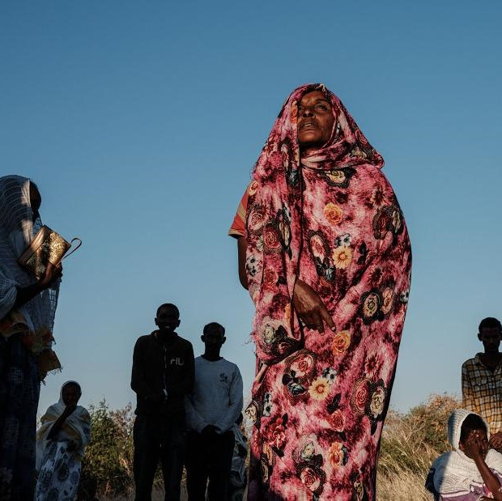
Tigray GBV Service Mapping
Facilitating Access to Minimum GBV Response Services

Slide 2
Service Mapping: Purpose & Objectives (Oct/Nov2021 Dec Analysis Jan published
Purpose: To access availability of existing GBV response services (health, psychosocial, legal and safety) in Tigray.
Objectives
identify what care and support services are currently available for GBV survivors, who the service providers are and where the services are located
develop a directory of services and update the inter-agency referral pathways
understand the capacity and quality of services
identify key gaps and capacity building needs of service providers
ensure effective and efficient multi-sectoral service delivery and coordination

Slide 3
Locations targeted (Zones)
Mekelle
Eastern
Central
North Western
Southern
South East

Slide 4
Outcomes of the Mapping Exercise
The GBV service coverage in the region and service packages currently provided;
An understanding of the manpower and technical capacities of the GBV service providers currently operating on the region;
Recommendations for scaling-up and improving the quality of GBV services;
Service directory to provides community members and institutions with information on locally available GBV response services ( Health, psychosocial and case management, legal, safehouse and security) their communities that survivors can make a choice of being referred to in a timely manner.

Slide 5
Services Mapping Findings
Out of the 88 accessible woredas in Tigray, GBV services are only functional in 37(42%) of them, with a total of 21 institutions providing services in health, psychosocial and case management support(, legal/justice, security/police, and shelter/safehouse. There is limited coverage and spread-out of services-mainly in Mekelle and Shire zonal areas.
Total of 39( 31 Government) facilities are providing health services, of which only 8 (21%) are providing comprehensive post-rape care for adults and children, with the remaining 69% providing partial post-rape care.
Total of 10 institutions primarily focused on 10 provision of CM &PSS
From the mapping, there is clear evidence of lack of systematic and coordinated referral mechanisms for GBV and CRSV cases across the region.
The limited capacity building activities provided to staff working within these service facilities has mainly involved training sessions.
Notes:
7 primarily health, 7(OSCs/IMC) primarily providing Health

Slide 6
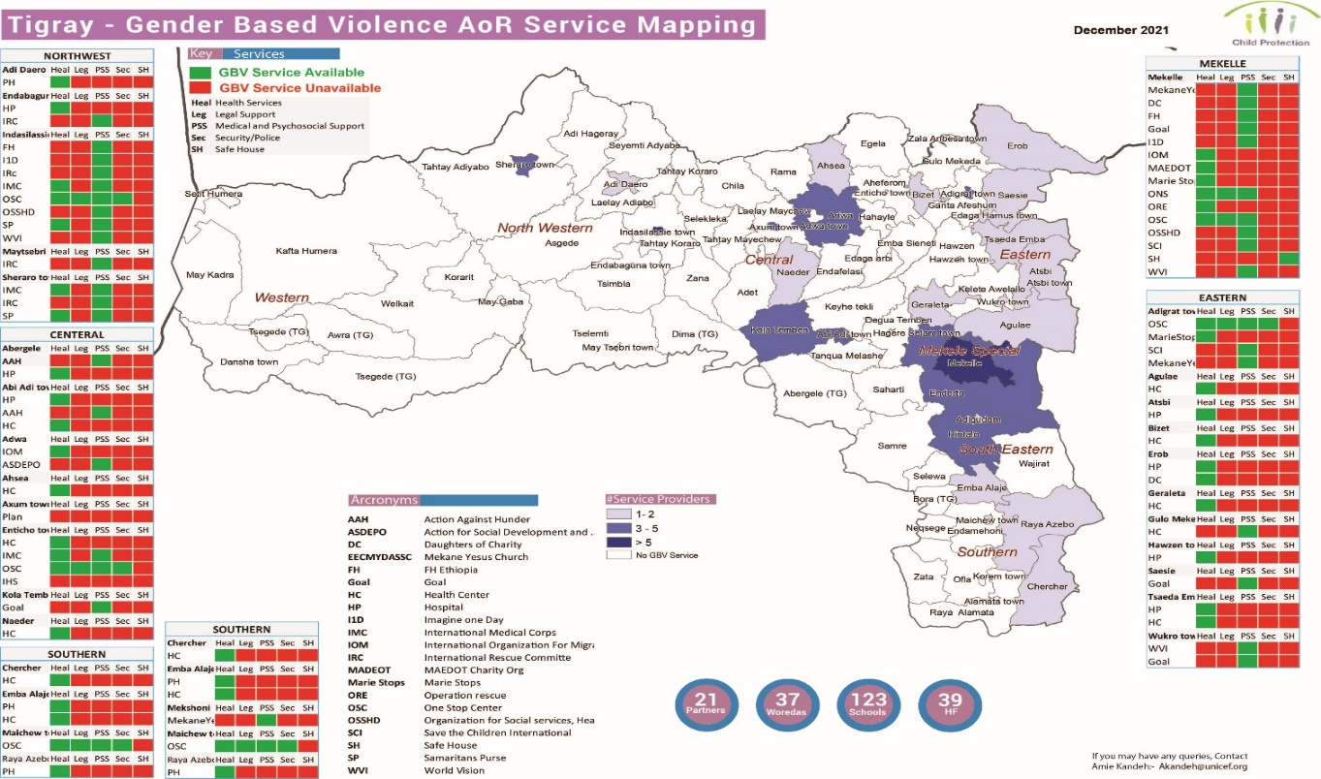

Slide 7
Health Service Packages – mapping facility (

Slide 8
CM & PSS Services Packages

Slide 9
Partner Capacity Building
Training Description | # of Institutions
Clinical Management of Rape Survivors | 2
Specialized GBV case Management | 6
Caring for child survivors | 1
Domestic Violence/Intimate Partner Violence Management | 2
GBV core concepts and referral pathways | 9
Psychological First Aid (PFA) | 7
Protection of Sexual Exploitation and Abuse (PSEA) | 9
Safe and ethical management of GBV data (GBVIMS) | 1
Staff mentoring and supervision tools | 9

Slide 10
Recommendations and next steps
Scale-up GBV services and service provision based on service mapping findings
Update the existing referral systems/pathways to increase access available GBV services
Develop a comprehensive GBV service directory for Tigray
Raise awareness on available GBV services and existing GBV referral pathways among partners and community members
In collaboration with the GBV AoR, develop and implement a GBV capacity building plan for GBV specialists and non GBV specialists
Increase GBV risk mitigation actions across programmes, clusters, communities, etc.

