Slide 1
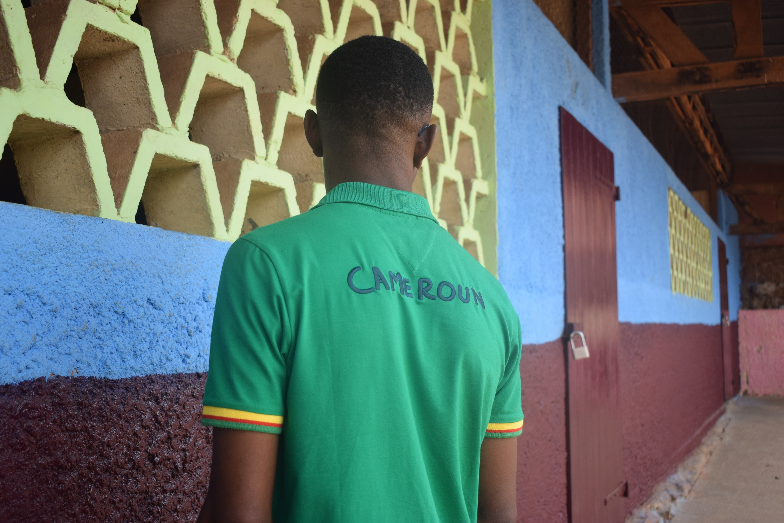

Cameroon’s North West and South West protection crisis
Why addressing the needs of adolescent boys and men affected by crises is beneficial to women and society at large
Delphine Brun, Inter-Agency GenCap advisor

Slide 2

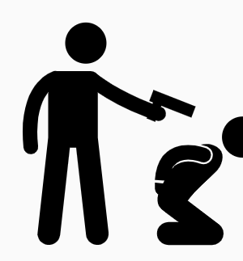
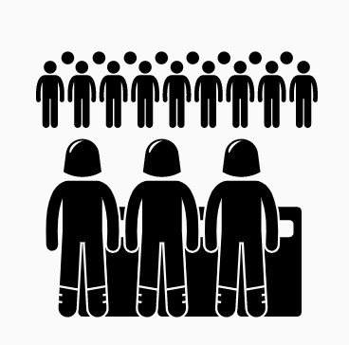
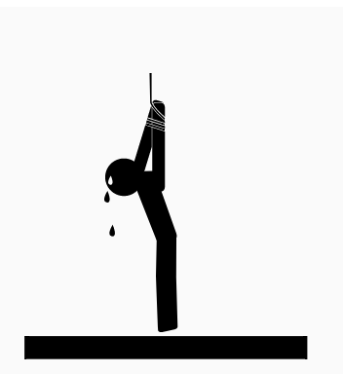
=
14% of GBV survivors are men and boys
Specific threats
Catched in a pincer movement
« Taking a neutral stand impossible.
There is no safe position you can adopt. »
Firmin, IDP, 24 years old
Arbitrary arrests, beating, illegal detention, torture, abduction, extra judicial killings and men missing
9 victims out of 10 are men and boys

Slide 3
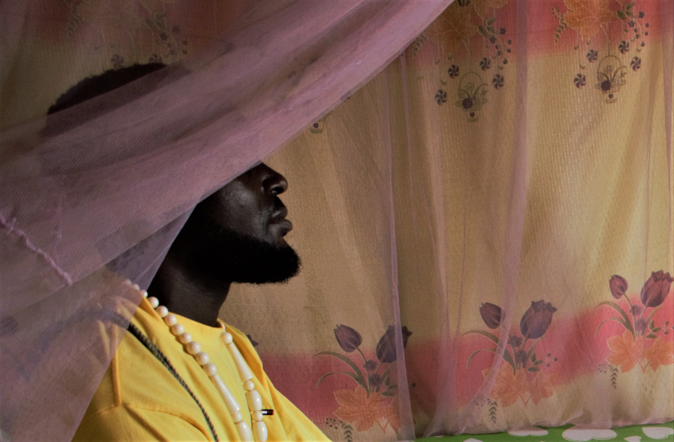
Poverty, insecurity and psychosocial costs
“Boys are stuck in their community. They don’t have education, and they have nowhere to go. Without a means to earn a livelihood, they are at great risk of recruitment“
Director of a local NGO, Northwest
“I feel powerless and I don’t know what the future looks like. The crisis has postponed so many things I was planning to do,” Divine, IDP, 36 years old
“Depression has really increased among adolescent boys and men. Addictions are on the rise too. Some face mental illnesses”
Psychiatric nurse, Northwest

Slide 4
Feeling a loss of identity and shifts in gender roles
“When we grew up, the first thing we had to do as men was get married and look after our wives, our mothers and our siblings... I had a fiancée before the crisis. But she left me because I didn’t have any money anymore. This was very hard. My mother sees me as a failure. She does not say much, but I can feel it” Georges, IDP, 35 years old
““At my place, I had a job. Here, I have nothing. I feel pain. I feel I am not man enough to look after my family”
John, IDP, 36 years old
“ Women can move where men used to go”
Protection staff, INGO, SouthWest

Slide 5





« Who should we assist ? » : Perceptions, myths et practices :
« Women and children first »
“Supporting men and boys comes at a risk”
« Men can’t be raped »
Cater
Lack of prioritization Inadequate services
Categorization of at-risk groups

Slide 6
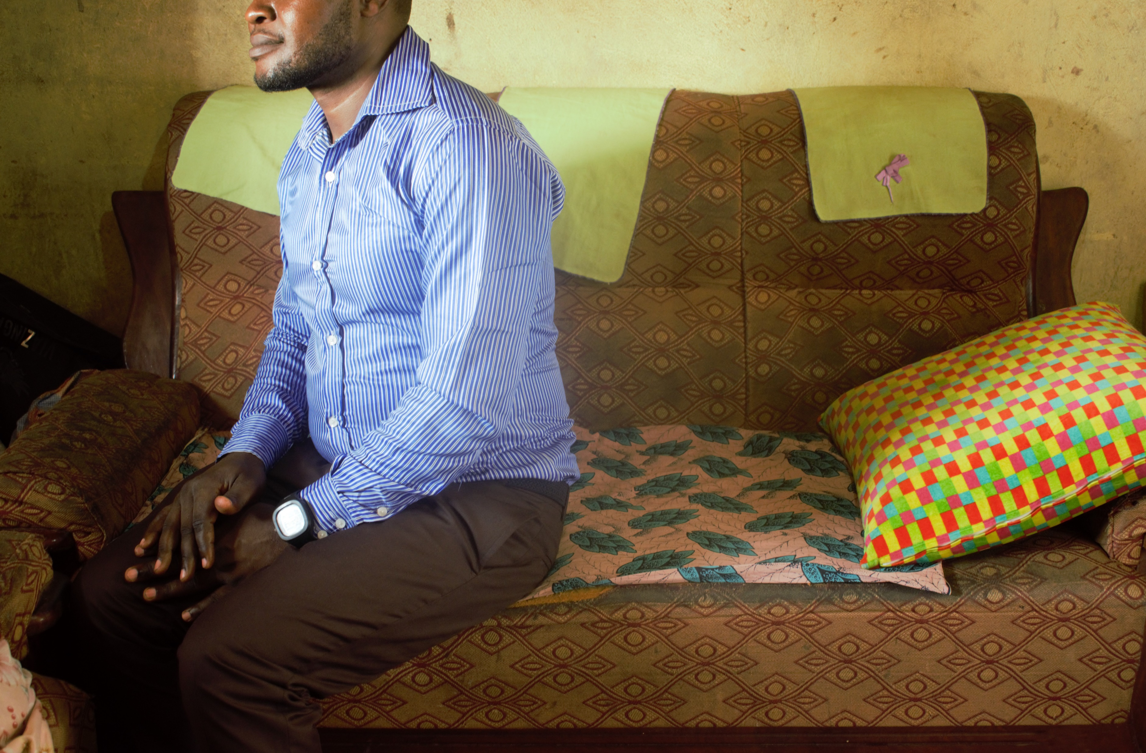
Recommendations
“When men are affected, women are the indirect victims”
GBV staff, INGO, NorthWest
Ensure your response is based on facts, not assumptions: Needs assessments and protection audits should review risks facing boys and men.
Identify existing networks where women and men can safely reflect about how they feel about societal expectations in terms of the “proper” behavior for females and for males and how they deal with not living up to such standards.
Gender-based violence against adolescent boys and men is a reality. Consider the specific barriers they face in accessing GBV services. Train protection and psychosocial staff to provide high-quality, age-appropriate, stigma-free, male-friendly services.

