Slide 1
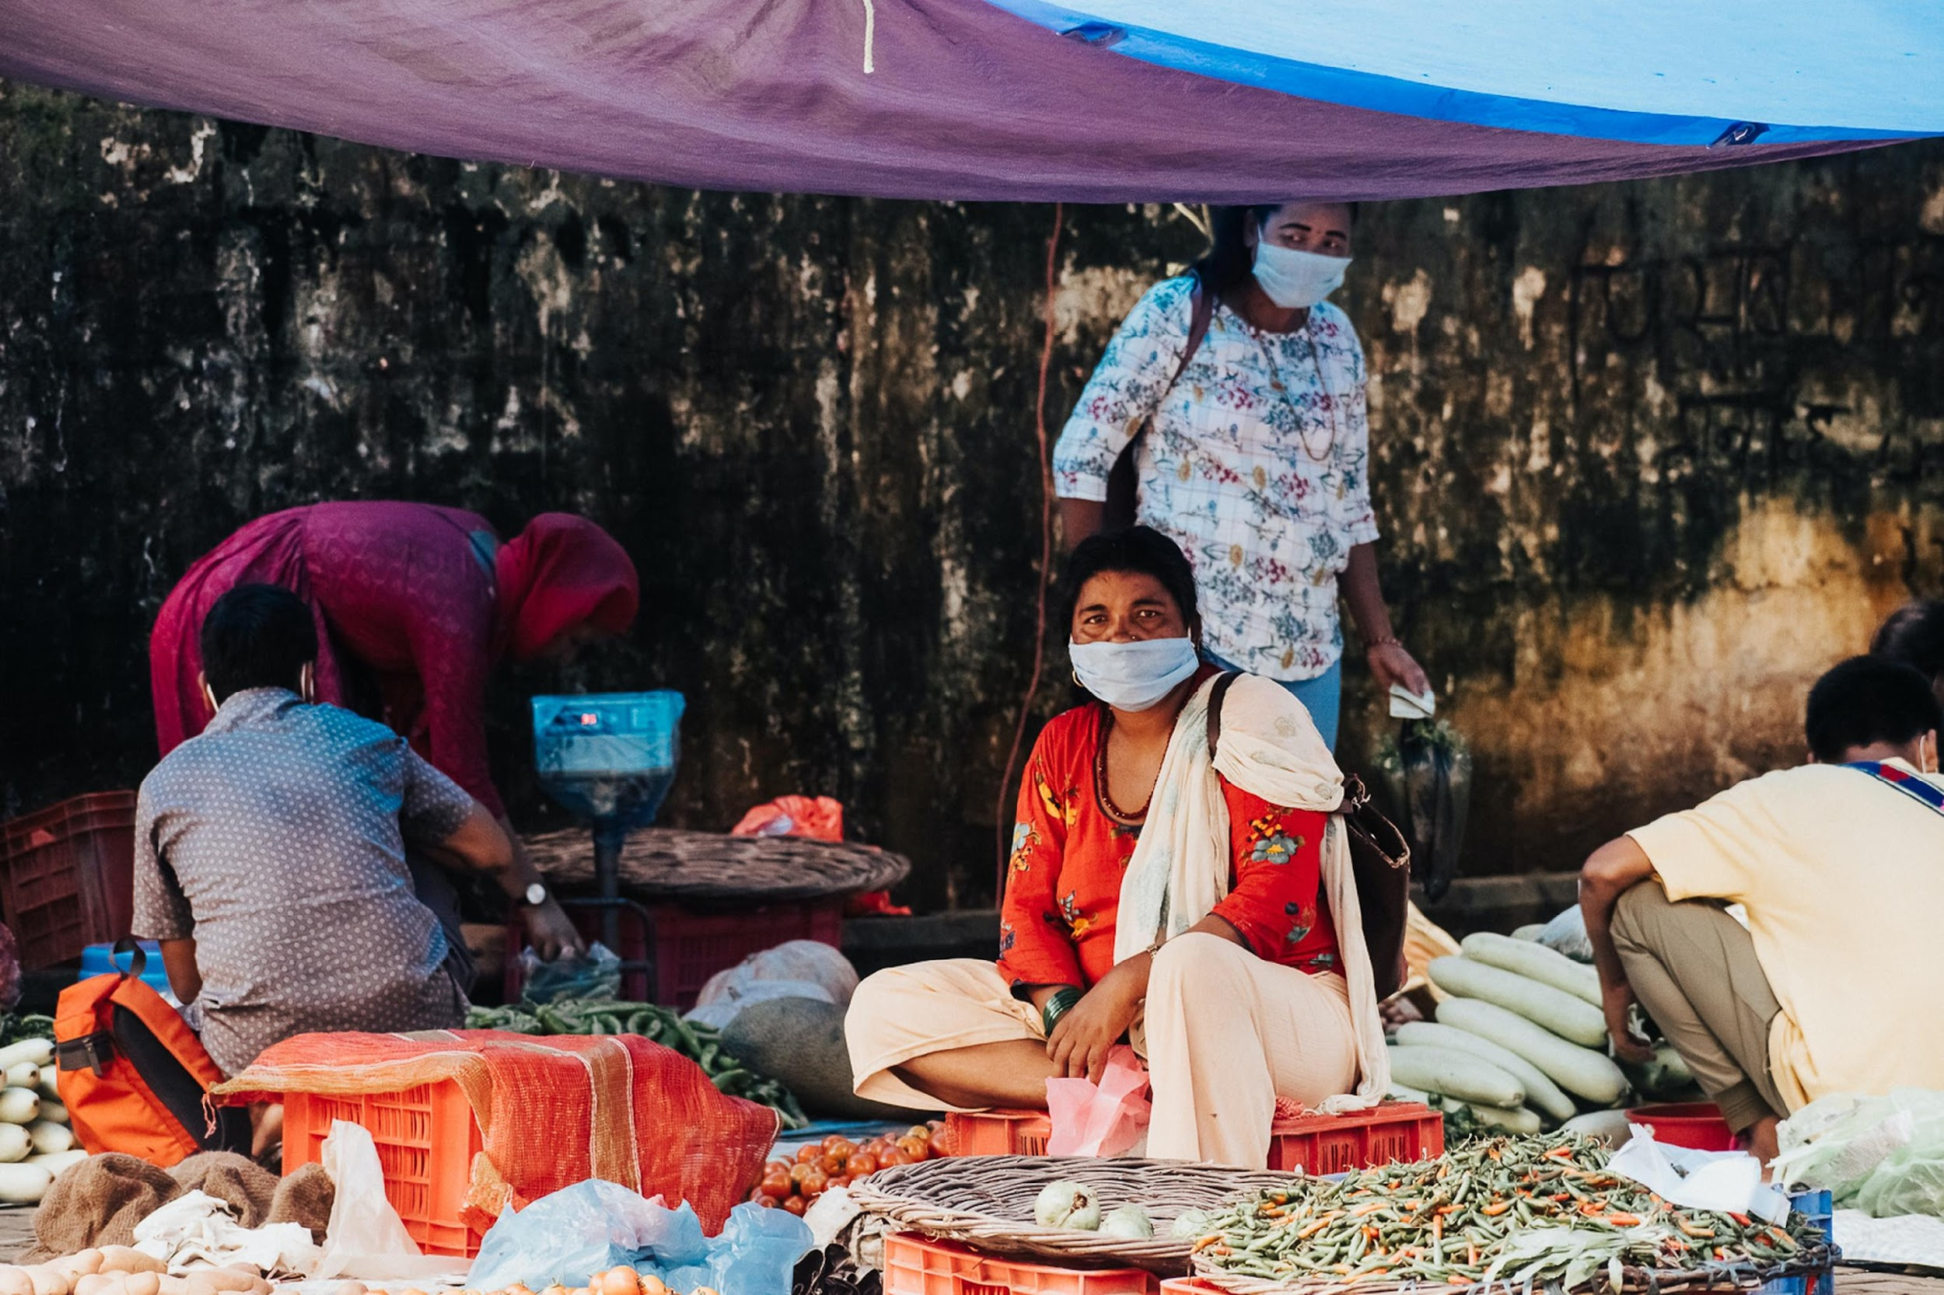


How to mitigate GBV risks in Cash and Voucher Assistance?
Introduction to (country name) CWG
(date & place)

Slide 2
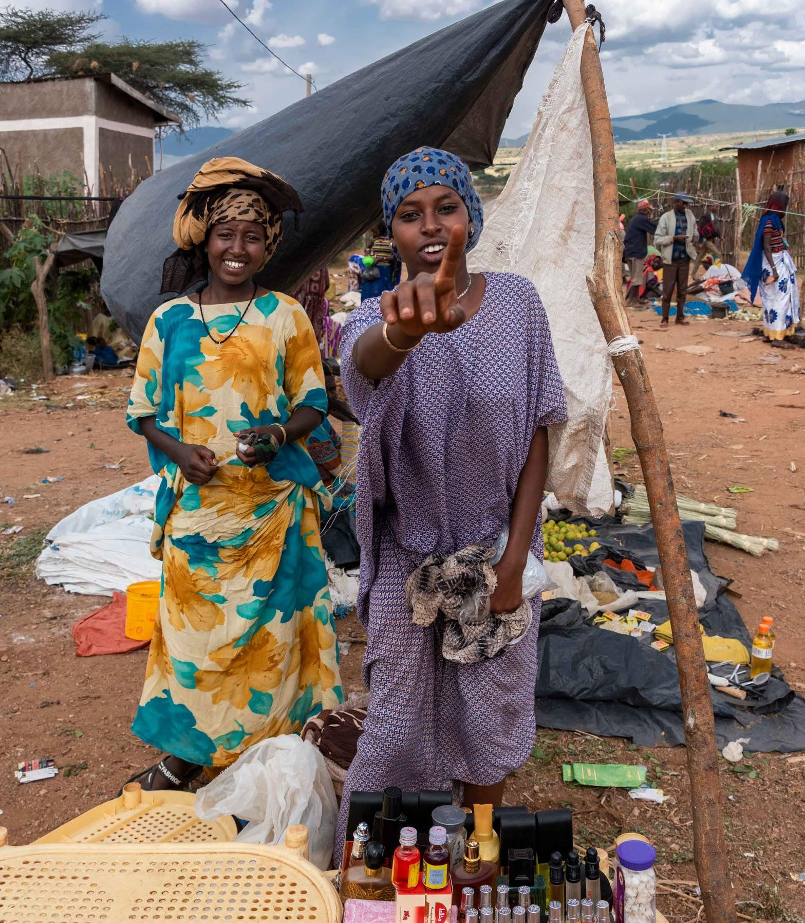

Agenda
What is Gender–based violence (GBV)?
Why is GBV risk mitigation required for CVA?
Identifying GBV risks in CVA intervention and what to do as cash actor
Key Resources

Slide 3

Key concepts of GBV (Gender-based Violence)
GBV: “An umbrella term for any harmful act that is perpetrated against a person’s will, and that is based on socially ascribed differences between males and females” (IASC definition)
Different types or forms of violence: (1) sexual; (2) physical; (3) harmful traditional practices; (4) socio-economic; and (5) emotional and psychological. Includes:
    Intimate Partner Violence (IPV)
    Early marriage
    Sexual exploitation and abuse
    Etc.
Humanitarian crisis = increase in GBV
    Majority of displaced are women single heads of households, more vulnerable and taking risks to get access to food/water
    Increase of domestic violence, early marriage/pregnancies, sexual exploitation, etc.
GBV is one of the most prevalent violations of human rights.

Slide 4
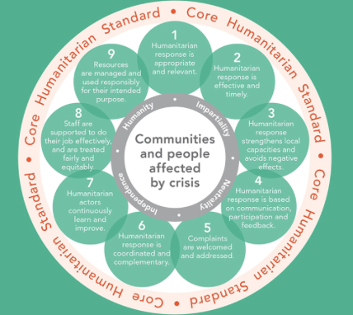




GBV risk mitigation in CVA: Why?
Beneficiaries are households, vulnerable individuals – including women and girls, with disabilities, older women… many at heightened risk of GBV.
Cash cannot contribute to self-reliance and resilience if it exacerbates risks.
Better programming for better outcomes and results!
“Do No Harm”
“Centrality of Protection”
Ensure proper and real access for vulnerable people to your services
Ensure your programmes do not cause GBV or create more GBV risks
Any humanitarian worker has a role of prevention and mitigation of GBV risks which is complementary to the work of GBV specialists who respond and manage GBV cases and their consequences.

Slide 5
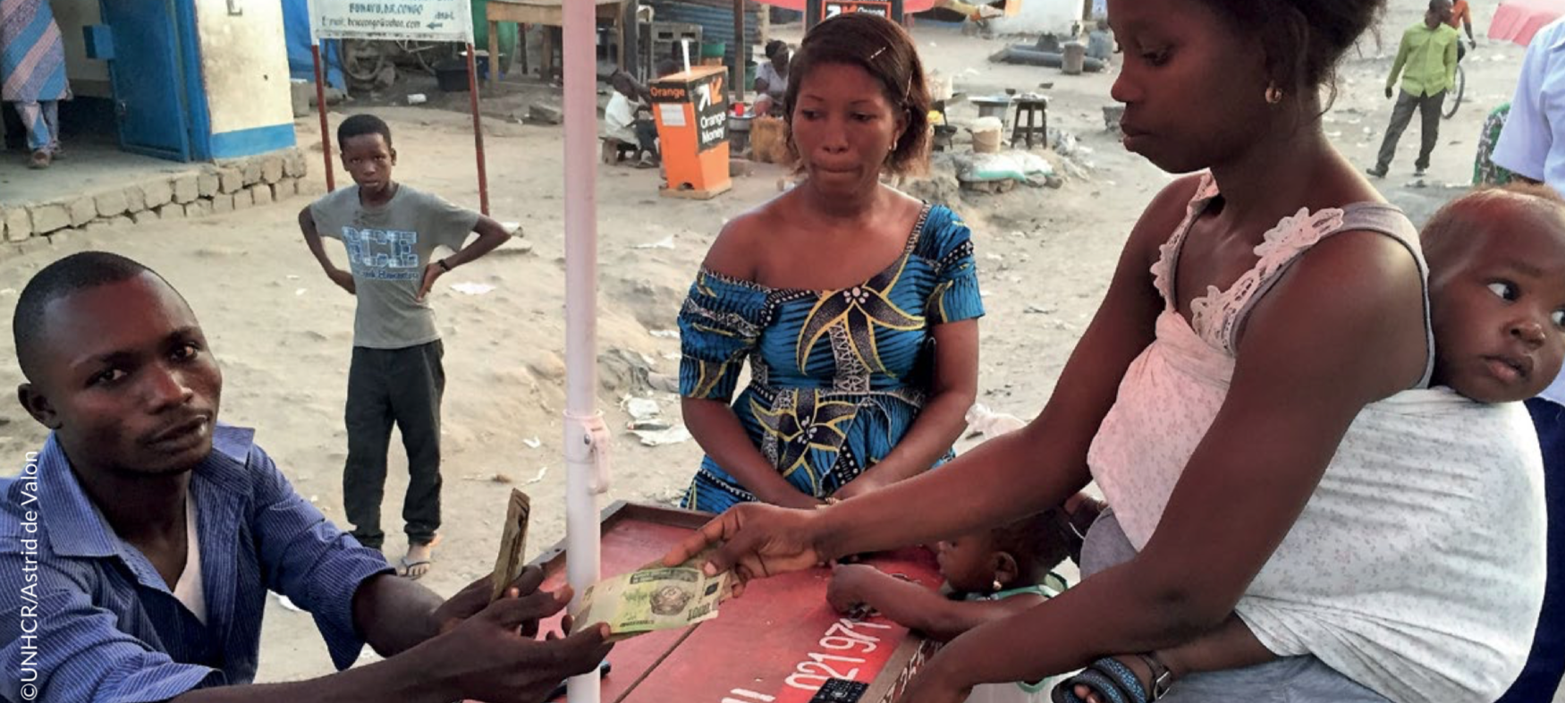
GBV Risk Mitigation in CVA:
What could go wrong?

Slide 6
Potential sources of GBV risks in CVA
Rushing the design phase - no GBV/Protection analysis, overlooking:
  Household dynamics
  Community pre-crisis gender dynamics
  Ensuring modality/delivery mechanism is accessible
  Risks of abuse of power / fraud, sexual exploitation & abuse
!
So, what to do?
Start every design of a CVA by a GBV/Protection Risk Analysis
Make sure to have in place:
  A strong feedback mechanisms (talk to beneficiaries!)
  Listen to needs / priorities of most vulnerable
  Link to GBV referral pathways
  Ensure your teams (incl. private mobile companies) have been trained + signed a Codes of Conduct
  Women personnel in your front line teams
Monitor regularly

Slide 7
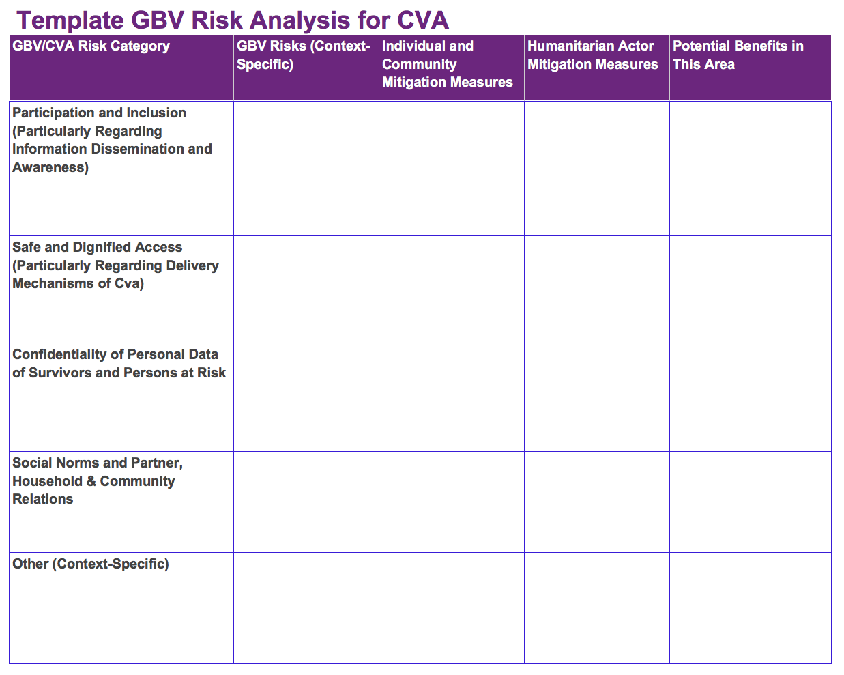
Template GBV Risk Analysis for CVA

Slide 8
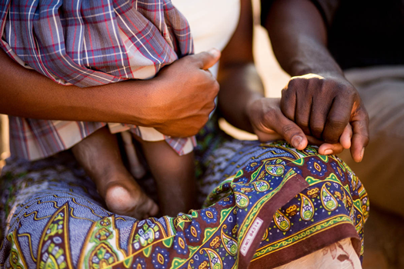
Key considerations
Non-protection specialists should never ask beneficiaries about any kind of personal experience of violence (GBV, domestic violence, sexual assault, etc.)
Ask question about general risks, trends or individual/community coping mechanisms
Should someone tell you about a GBV incident or report a case - do not handle it but provide the person contact details of specialised service(s)
For more info on this: check the GBV pocket guide (available in many languages & as an App!)
… and make sure you have consulted GBV or protection colleagues before you undertake any evaluation / field visit / FGD, etc!

Slide 9
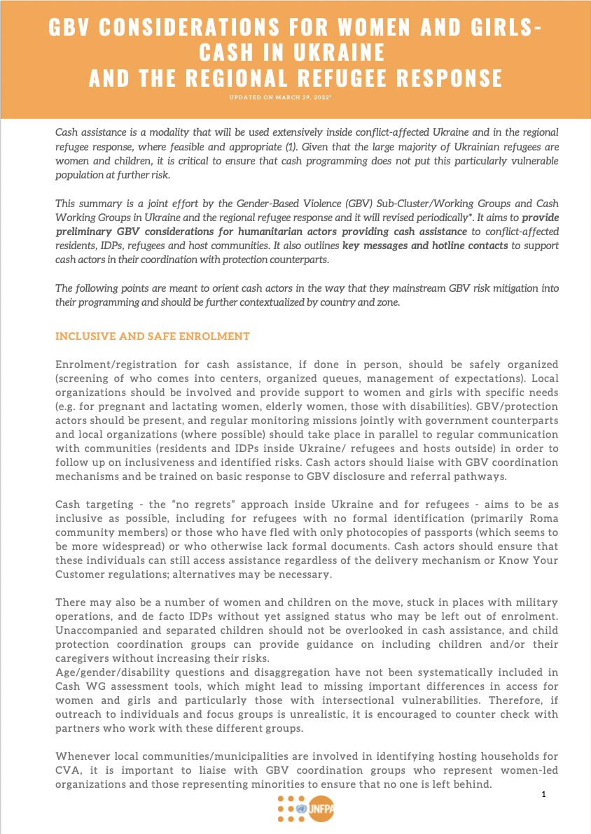
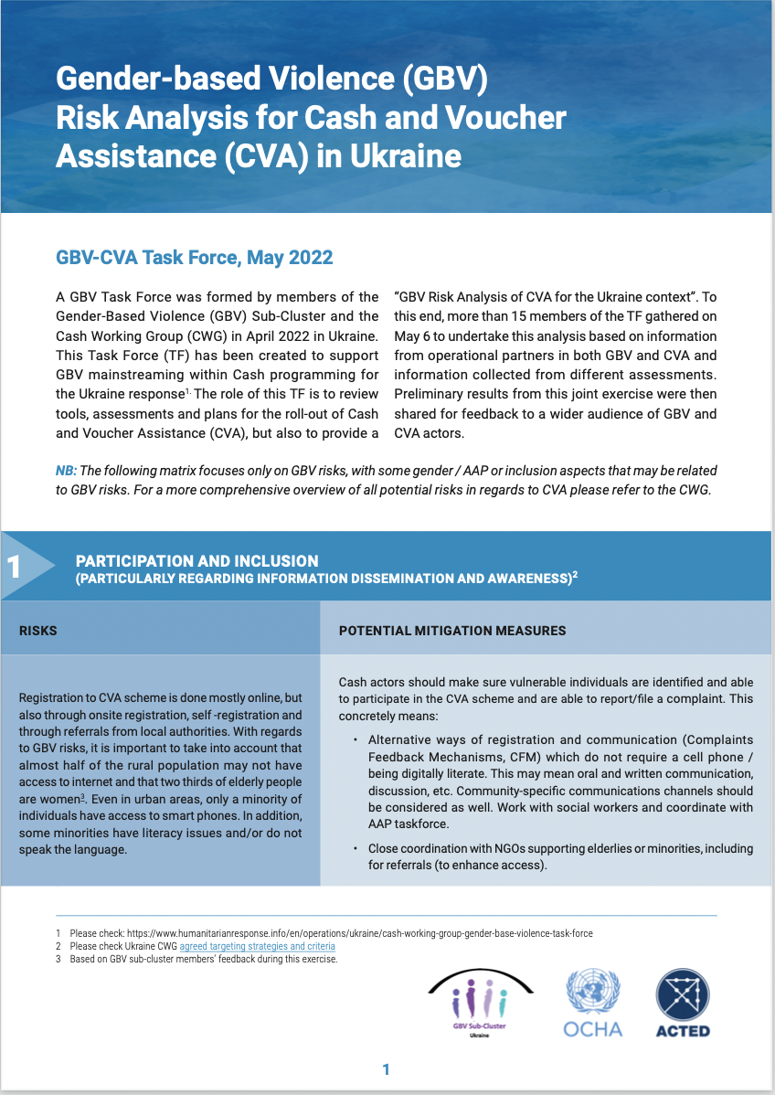
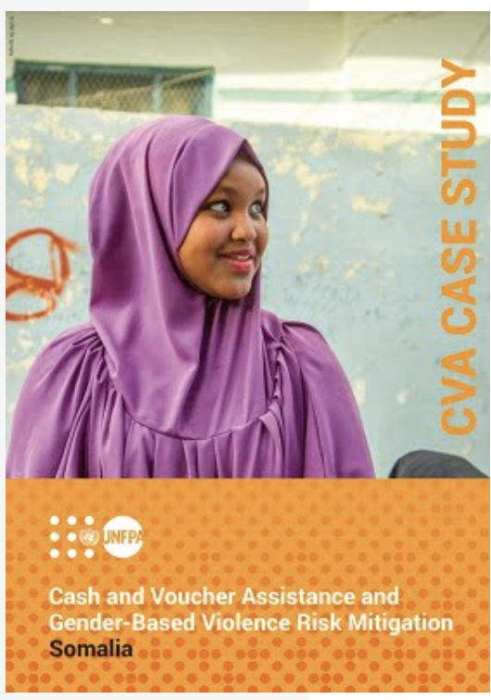
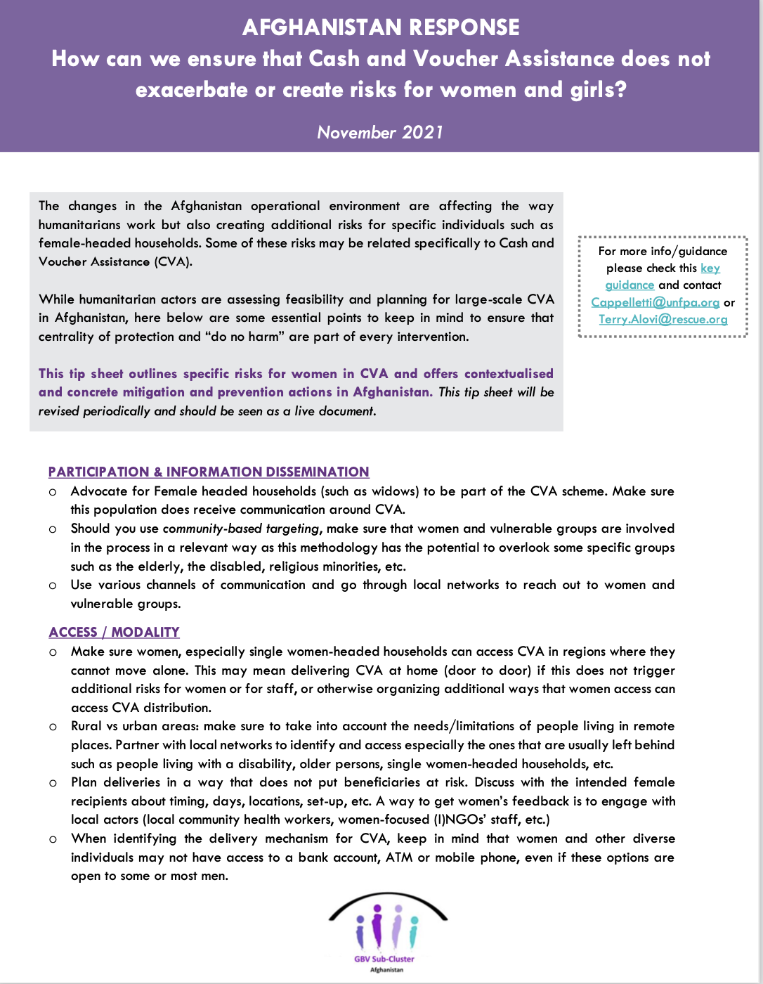
Learning from the field
NW Syria: CWG - GBV wg taskforce (SoPs for referral of GBV cases to CVA, contribute to CVA feasibility assessment, etc.)
Ukraine & Moldova: GBV-CVA task force for Ukraine, revision of tools (PDM, Market analysis, CoC for hosting families, joint risk analysis, etc.)
Iraq: GBV-CVA task force and upcoming joint workshop (this June)
Afghanistan: tipsheet for cash actors, revision of interagency PDM, training of FSPs, checklist with success indicators, etc.
Also Somalia, Burundi, Myanmar

Slide 10
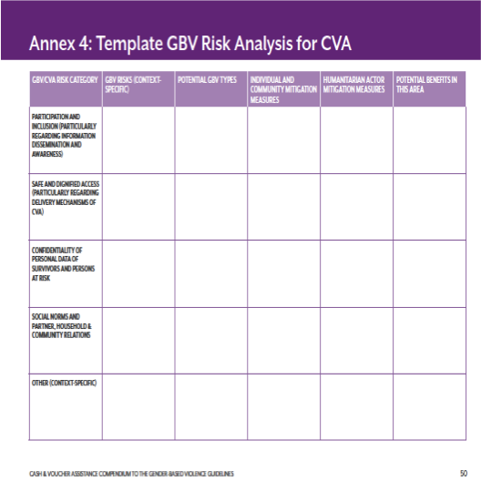
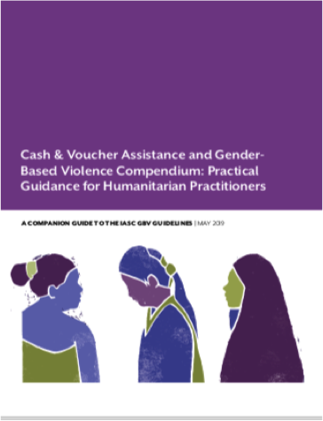
Key resources
TOOLKIT
Your GBV / Protection colleagues!
GBV Sub-cluster/coordination group (insert names + contact details)
Insert link to GBV pocket guide in your language
CVA and GBV Compendium (Practical guide)
See page 50 for the GBV risk evaluation matrix
Available in many languages
COVID-19 Pandemic Cash and Voucher Assistance for Protection Considerations
Thank you for your time and interest!

Slide 11
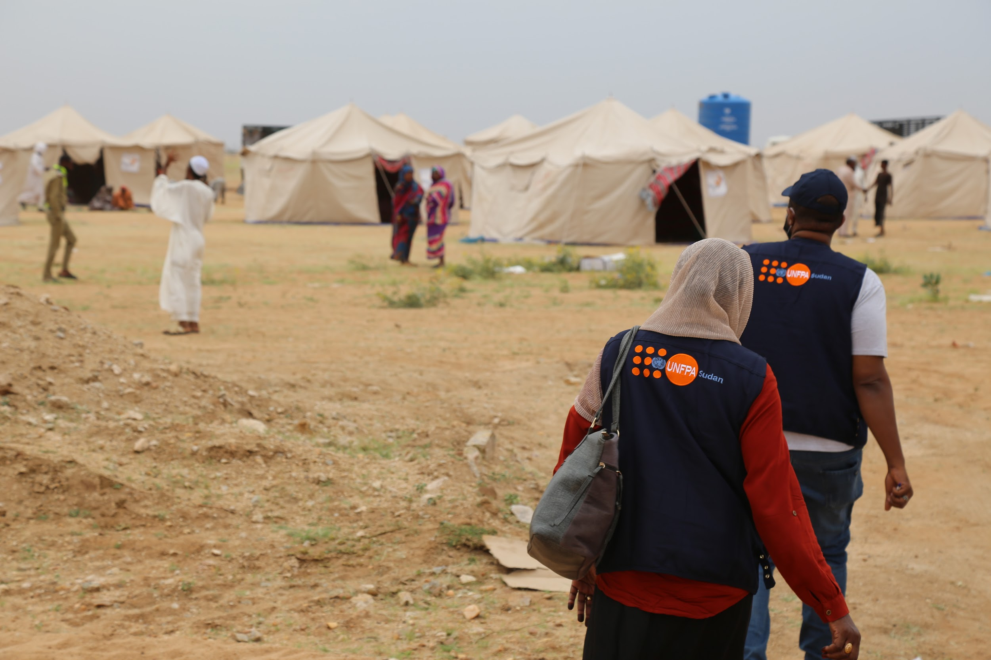
Group work
Scenario:
You are planning on using e-transfers in urban areas. Because you had a gender equity component in your programme you decided to target only women for a cash distribution. After the first distribution you hear back from some communities that women were experiencing tensions in their households.
Step 1: Analyze the GBV risks in the scenario, using the IASC CVA and GBV risk matrix tool to guide your discussion.
Step 2: Discuss some actions you can take to address those risks.

